Slide 1
Y0057_SCAN_11335_2019_C IA 12062021

Slide 2
Agenda
During this meeting we will discuss:
Medicare History
Eligibility Requirements
Different Parts of Medicare
Election Periods
Medicare Resources
Star Rating and how if impacts SCAN
Notes:
During this meeting we will discuss:
Medicare Basics
Including its history and how it works
Medicare Advantage Plan Basics
And how it works
Eligibility requirements
Election Periods
Medicare resources

Slide 3
Medicare History

Slide 4
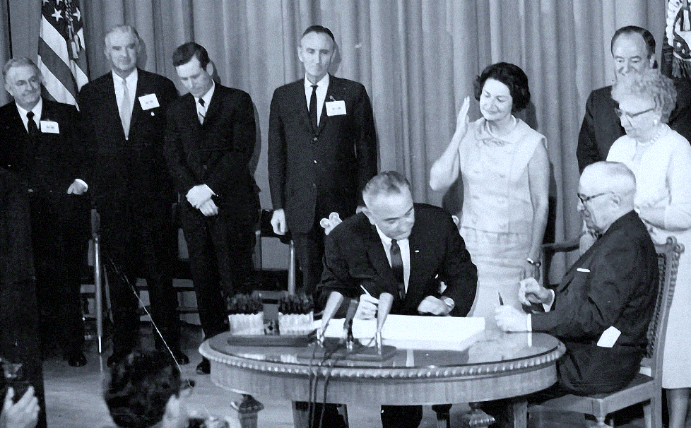
A Brief History of Medicare
1965
President Lyndon B. Johnson
1972
President Richard M. Nixon
2003
President
George W. Bush
Connections Badge
Sales Support Team
Complete Application
Signed Medicare into law* in Independence, Missouri
President Harry S. Truman received the 1st Medicare card during the ceremony
Extended Medicare to individuals under 65 with certain disabilities and End Stage Renal Disease (ESRD)
Improved Medicare further by including prescription drug coverage (Part D)
*H.R. 6675 ACT Provides insurance for the aged.
Notes:
July 30, 1965 – President Lyndon B. Johnson made Medicare a law by signing the H.R. 6675 ACT in Independence, Missouri
President Harry S. Truman received the 1st Medicare card at the ceremony
1972 – President Richard M. Nixon extended Medicare to individuals under 65 with certain disabilities and End Stage Renal Disease (ESRD)
2003 – President George W. Bush improved Medicare further by including prescription drug coverage (Part D)

Slide 5
What is Medicare?
Federally funded healthcare program
A program that helps with health care costs
Does not cover all medical expenses
Administered by CMS
Paid for through 2 trust fund accounts held by the U.S. Treasury
Funds can only be used for Medicare.
Notes:
Medicare is an “entitlement” program automatically offered to people who have paid into the Social Security system for minimum of 10 years (or a total of 40 quarters) of employment. As an entitlement program it is not based on a person’s income. Wealthy people are entitled to it same as those with limited incomes.
Medical services are based on a fee-for-service based upon approved­ rates between Medicare and the medical providers. The beneficiary is responsible to pay for the dollar differences between the ­approved rates and the actual fees charged by the medical providers
Legislation in 1965 enacted the Medicare program and it is administered by the Social Security Administration (SSA). In 2001, SSA assigned the Center for Medicare and Medicaid Services (CMS) to manage the responsibilities and distribution of social security funds for medical services.
Medicare is the federal health insurance program for people who are 65 or older, certain younger people with disabilities, and people with End-Stage Renal Disease (permanent kidney failure requiring dialysis or a transplant, sometimes called ESRD or stage 5 kidney failure)
Resource:
medicare.gov/what-medicare-covers/your-medicare-coverage-choices/whats-medicare
https://www.medicare.gov/about-us/how-is-medicare-funded

Slide 6
Who is Social Security?
Social Security Administration (SSA) is a federal government agency that:
Administers Social Security benefits
Enrolls beneficiaries into Parts A & B (Original Medicare)
Distributes Medicare cards to beneficiaries
Qualifies beneficiaries for “Extra Help,” also known as Low Income Subsidy (LIS)
Notes:
Social Security Administration (SSA) is a Federal government agency that
Administers Social Security benefits for all working and retired Americans
Responsible for enrolling beneficiaries into Parts A & B (original Medicare)
Distributes Medicare cards to beneficiaries
Qualifies beneficiaries for Low Income Subsidy “Extra Help”
Resources:
https://www.ssa.gov/people/materials/pdfs/EN-05-10230.pdf
www.usa.gov

Slide 7
Who is CMS?
CMS administers Medicare and Medicaid programs
Provides oversight
Collects and analyzes data
Produces research reports
Eliminate instances of fraud and abuse within the healthcare system
Release updated Medicare premium and deductible information annually
Headquarters located in Baltimore, Maryland
Notes:
Medicare is administered by the Centers for Medicare & Medicaid Services (CMS), a division of the U.S. Department of Health & Human Services (HHS) and is jointly funded by the federal and state governments.
It collects and analyzes data, produces research reports, and works to eliminate instances of fraud and abuse within the healthcare system.
The agency aims to provide a healthcare system with better care, access to coverage, and improved health.
The CMS releases updated Medicare premium and deductible information each year.

Slide 8
Eligibility Requirements

Slide 9
General Medicare Eligibility
Age 65 or older
Under age 65 with certain disabilities
Amyotrophic Lateral Sclerosis (Lou Gehrig’s Disease)
End-Stage Renal Disease (ESRD)
U.S. citizen or a permanent resident
Lawfully residing in the U.S. for at least 5 consecutive years
Notes:
Medicare Eligibility
Age 65 or older
Under age 65 with certain disabilities
Amyotrophic Lateral Sclerosis (Lou Gehrig’s Disease)
End-Stage Renal Disease
U.S. citizens, or a permanent resident lawfully residing in the U.S. for at least 5 consecutive years
Resource:
https://www.hhs.gov/answers/medicare-and-medicaid/who-is-elibible-for-medicare/index.html

Slide 10
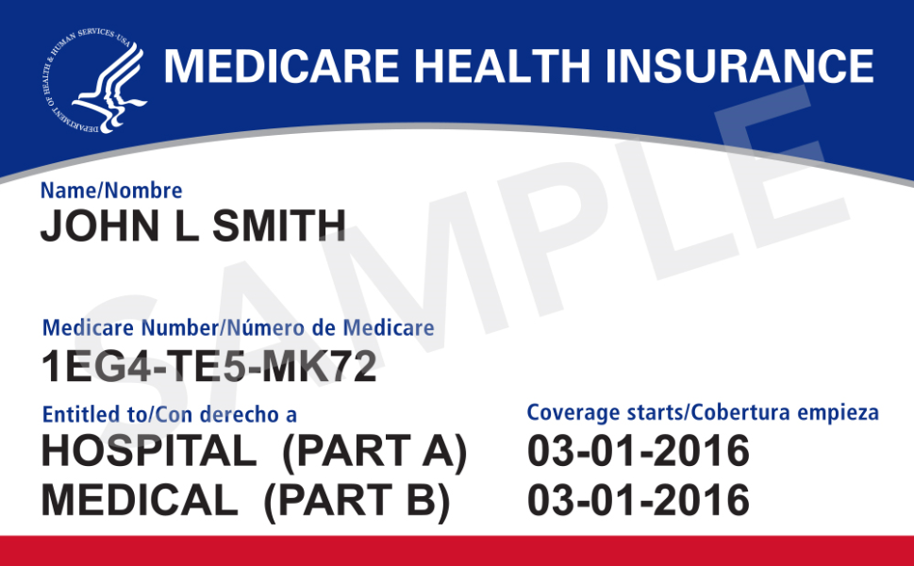
Medicare Card
Referred to as
Red, White and Blue card
How to replace your lost or damaged Medicare card
Call 1-800-MEDICARE
(1-800-633-4227)
TTY users: 1-877-486-2048
Ask for a replacement card to be sent in the mail.
Notes:
Here are a few things to remember regarding your Medicare card:
• Keep your other plan cards
If you’re in a Medicare Advantage Plan (like an HMO or PPO) or a Medicare drug plan, keep using that Plan ID card whenever you need care or prescriptions. However, you should carry your new Medicare card too—you may be asked to show it.
• Protect your Medicare Number like you do your Social Security Number
Only give your new Medicare Number to doctors, pharmacists, other health care providers, your insurer, or people you trust to work with Medicare on your behalf.
If you did not receive or have lost your Medicare card.
For a replacement:
Call 1-800-772-1213
TTY – 1-800-325-0078
Visit your local Social Security office
Resources:
Online: https://faq.ssa.gov/en-US/Topic/article/KA-01735
Replacement card information from Medicare and You 2022 handbook
https://www.medicare.gov/Pubs/pdf/10050-medicare-and-you.pdf

Slide 11
Different Parts of Medicare

Slide 12
Different Parts of Medicare
Hospital Insurance
No Premium if the beneficiary meets the requirement
Medical Insurance
Standard monthly premium $170.10
Medicare Advantage Plans
Must have
Parts A & B
Prescription Drug Coverage
Must enroll in Part A and/or B to enroll in Part D
Both Part C and D - Plan options vary by county
Notes:
Different parts of Medicare. No need to spend too much time on this slide. The subsequent slides will go into detail.
Medicare Part A
In general, Part A covers:
Premium free*
Inpatient care in hospital
Skilled nursing facility care
Inpatient care in skilled nursing facility (not custodial or long-term care
Hospice care
Home health care
*Buy-in option available for those who do not qualify for the premium free.
Medicare Part B
In general, Part B covers:
Doctor and other health care providers' services and outpatient care. Part B also covers durable medical equipment, home health care, and some preventive services.
Includes Standard monthly premium
Medicare Advantage Part C
Medicare Advantage Private Health Insurance
Covers services not covered under Original Medicare:
Physician & Hospital visits
Prescriptions
Other benefits & services (Vision, Dental, OTC, etc.)
Medicare Part D
Helps pay for prescription drugs (Brand and Generic medication)
Must enroll in Part A and/or B to enroll in Part D
https://www.medicare.gov/basics/get-started-with-medicare/medicare-basics/parts-of-medicare
https://www.medicare.gov/what-medicare-covers
https://www.medicare.gov/sign-up-change-plans/types-of-medicare-health-plans/medicare-advantage-plans
https://www.medicare.gov/drug-coverage-part-d
https://www.medicareinteractive.org/get-answers/medicare-basics/medicare-eligibility-overview/medicare-part-d-drug-benefit-eligibility
2022 premium: https://www.cms.gov/newsroom/fact-sheets/2022-medicare-parts-b-premiums-and-deductibles2022-medicare-part-d-income-related-monthly-adjustment
Medicare and You handbook

Slide 13
Medicare Part A
Hospital Insurance
Helps cover hospital-related services:
Emergency care
Hospital care
Hospice care
Home health care
Inpatient care
Skilled nursing facility care
PART A
Individuals are generally responsible for premiums, deductibles & 20% of the coinsurance

Slide 14
Qualifying for Medicare Part A
Individuals can get premium-free Part A at 65 if they:
Receive or are eligible for retirement benefits from Social Security or the Railroad Retirement Board
Or their spouse had Medicare-covered government employment
If under 65, the individual can get premium-free Part A if they:
Received Social Security or Railroad Retirement Board disability benefits for 24 months
Have End-Stage Renal Disease (ESRD) and meet certain requirements
Notes:
Most people get Part A for free, but some have to pay a premium for this coverage.
To be eligible for premium-free Part A:
An individual must be entitled to receive Medicare based on their own earnings or those of a spouse, parent, or child.
The worker must have a specified number of quarters of coverage (QCs) and file an application for Social Security or Railroad Retirement Board (RRB) benefits.
The exact number of QCs required is dependent on whether the person is filing for Part A on the basis of age, disability, or End Stage Renal Disease (ESRD).
NOTE: Certain Federal, State, and local government employees pay only the Part A portion of the FICA tax. The QCs they earn can be used only to meet the requirements for premium-free Part A; they may not be used to meet the requirements for monthly Social Security benefits.
Resource:
https://www.cms.gov/Medicare/Eligibility-and-Enrollment/OrigMedicarePartABEligEnrol

Slide 15
Qualifying for Medicare Part A
If individuals don't qualify for premium-free Part A,
they can buy into Part A
In most cases, if the individual chooses to buy Part A, they must also:
Part A monthly premium depends on how long the individual or their spouse worked and can pay:
$274 or up to $499 each month
If an individual chooses NOT to buy Part A, you can still buy Part B.
Have Medicare Part B (Medical Insurance)
Pay monthly premiums for both Part A and Part B
Notes:
To be eligible for premium Part A, an individual must be age 65 or older and be enrolled in Part B. Enrollment in premium Part A and Part B can only happen at certain times. (The section titled Enrollment Periods and When Coverage Begins explains the times when someone can enroll).
Resourced:
https://www.medicare.gov/your-medicare-costs/medicare-costs-at-a-glance
https://www.cms.gov/Medicare/Eligibility-and-Enrollment/OrigMedicarePartABEligEnrol
https://www.medicare.gov/your-medicare-costs/part-a-costs

Slide 16
Medicare Part B
Medical Insurance
Helps cover doctor’s visits:
Primary and Specialist
Outpatient care
Home health care
Durable medical equipment
Many preventative services
PART B
Individuals are generally responsible
for 20% of the coinsurance.
Notes:
Medicare and You Handbook 2022:
Part B (Medical Insurance) Helps cover: • Services from doctors and other health care providers • Outpatient care • Home health care • Durable medical equipment (like wheelchairs, walkers, hospital beds, and other equipment) • Many preventive services (like screenings, shots or vaccines, and yearly “Wellness” visits)
hospital stays, but not limited to Blood Tests, X-rays, Durable medical equipment such as Wheelchair and Hospital bed

Slide 17
Qualifying for Medicare Part B
Once entitled to Part A (premium-free), individuals are eligible to enroll in Part B
Paying into the Part A premium, individuals must meet the following requirements to enroll in Part B:
Be age 65 or older
Be a U.S. resident AND Be either a U.S. citizen or alien OR
Be an alien
Alien who has been lawfully admitted for permanent residence and is residing in the United States for 5 straight years prior to the month of filing an application for Medicare.
Those
Notes:
Individuals already receiving Social Security or RRB benefits at least 4 months before being eligible for Medicare and residing in the United States (except residents of Puerto Rico) are automatically enrolled in both premium-free Part A and Part B.
People who are automatically enrolled have the choice whether they want to keep or refuse Part B coverage. People living in Puerto Rico who are eligible for automatic enrollment are only enrolled in premium-free Part A; they must actively enroll in Part B to get this coverage.
Individuals who are not receiving a Social Security or RRB benefit are not automatically enrolled. Individuals who previously refused Part B, or who terminated their Part B enrollment, may enroll (or re-enroll) in Part B only during certain enrollment periods.
In most cases, if someone does not enroll in Medicare Part B (Medical Insurance) when first eligible, they will have to pay a late enrollment penalty for as long as they have Part B.
Resource:
https://www.cms.gov/Medicare/Eligibility-and-Enrollment/OrigMedicarePartABEligEnrol

Slide 18
Medicare Part C Coverage
PART B Medical Insurance
PART C
MAPD Plans
Private Insurance Companies
PART A Hospital Insurance
Additional Coverage*
Vision, Dental, Gym, etc.
*Additional coverage may vary depending on the plan and county
MAPD – Medicare Advantage Prescription Drug
Notes:
Part C is a Medicare Prescription Drug Plan (MAPD). These are plans with prescription drug coverage
Offered by private companies
Often offers additional coverage like vision, gym and dental
Additional coverage may vary depending on plan and county

Slide 19
Medicare Part C Coverage
Medicare approved private insurance companies
Benefits may vary depending on the plan and county
Private Insurance companies have contracts
Plans may include:
Prescription drug coverage (Part D)
Additional coverage (dental, gym, vision, etc.)
To apply for Part C, beneficiaries MUST have Medicare Parts A & B
Medicare Advantage plans follow the rules set by Medicare but are not affiliated nor endorsed by Medicare.
Notes:
https://www.medicare.gov/sign-up-change-plans/types-of-medicare-health-plans/medicare-advantage-plans/how-do-medicare-advantage-plans-work

Slide 20
Medicare Part D
Prescription Drug Coverage
Help cover:
Cost of prescription drugs
PART D
Formulary listing and cost may vary depending on the plan and county.

Slide 21
Medicare Part D
Prescription Drug Coverage
Plans that offer Medicare drug coverage (Part D) are run by private insurance companies that follow the rules set by Medicare.
Part of a Medicare Advantage Prescription Drug (MAPD) plan
May be a stand-alone Prescription Drug Plan (PDP)
To receive Extra Help, one must be eligible for from the state
Medicare Part C:
MAPD = Prescription drug coverage
MA = No prescription drug coverage
Abbreviations and meaning:
MAPD – Medicare Advantage Prescription Drug plan
MA – Medicare Advantage
Notes:
Medicare and You hand book.

Slide 22
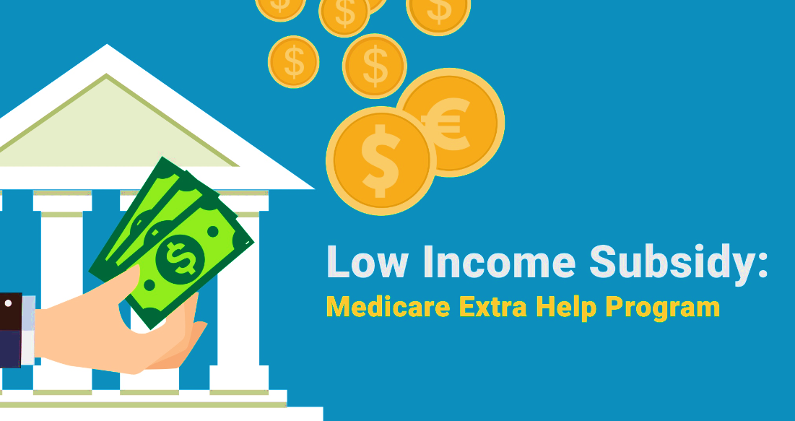
What is Extra Help/Low Income Subsidy (LIS)?
It is a federal program that may help pay out-of-pocket costs for some of the vast majority of Medicare prescription drug coverage. Extra Help is also known as or called Part D Low-Income Subsidy (LIS).
Extra Help / LIS:
Offered by Social Security Administration (SSA) to people with limited income and resources
One must apply and qualify to receive benefits
Helps pay for deductibles, premiums, and co-payments
Visit SSA.gov for additional information.
Notes:
Eligible beneficiaries who have limited income may qualify for a government program that helps pay for Medicare Part D prescription drug costs
Resource:
ssa.gov/benefits/medicare/prescriptionhelp/

Slide 23
Original Medicare vs. Medicare Advantage
 | ORIGINAL MEDICARE | MEDICARE ADVANTAGE
Premium | Most people don’t pay a monthly premium for Part A The premium for Part B will vary based on the individuals’ household income. | Varies depending on the plan. All plan enrollees (for specific plan and county) pay the same premium regardless of age or health history.
Doctors | Go to any doctor that accepts Medicare. | Choose a Primary Care Physician (PCP) within the specific Medicare Advantage Plan network.
Specialist | Go to any specialist that accepts Medicare. | Works together with the selected PCP to provide care.
Prescription Drugs | Choose a separate Part D Plan with a monthly premium. | Drug coverage is included in most plans. In many Medicare Advantage Plans, you don’t need to join a separate Medicare drug plan.
Health Care Coordination | Medical and Hospital Only. No Part D or Coordinate Care | Medical, hospital, and Prescription drug data is centralized for better coordination.
Notes:
Resource:
https://www.medicare.gov/Pubs/pdf/10050-Medicare-and-You.pdf

Slide 24
Medicare Advantage
Member
Primary Care
Physician
Health Care Team
Specialist
Pharmacy
Labs
Notes:
Having a coordinated Health Care Team is beneficial to your well-being
Once you become a member of a Medicare Advantage Plan, you will work together with your PCP to coordinate care with your Specialists, Pharmacy, Hospital, Lab, etc.
PCP – Service as the first contact for members routine services and health concerns
Pharmacy – Members can get prescribed medications
Labs – Members can get routine and diagnostic lab test
Specialist – Members are referred to Specialist based on medical necessity

Slide 25
Election Periods

Slide 26
Medicare's Initial Enrollment Period
Initial Enrollment Period:
This initial Enrollment Period (IEP) is the first time the individual can sign up for Medicare.
3-months before the individual’s 65th birthday
The month of the individuals birthday
3-months after the individual’s 65th birthday
Explanation:
Initial eligibility for Medicare begins the 3-months before the individual’s 65th birthday, and it continues through the 3-months after their 65th birthday.
If the individual is not enrolled in Medicare because of a disability or chronic condition, this will be the opportunity to sign up.
Notes:
May enroll 3 months prior to birth month, birth month, and 3 months after birth month (7 months total) Eligible beneficiaries who have limited income may qualify for a government program that helps pay for Medicare Part D prescription drug costs
NOTE- Avoid a Late Enrollment Penalty (LEP) by enrolling during your IEP

Slide 27
Q&A: Delay Signing-up for Part B?
Questions
Answers
What if I do not sign up for Part B when eligible?
The penalty is a 10% higher premium for every 12-month period that you were eligible for Medicare Part B but didn’t sign up for it.
How and when do I enroll in Part B after I’ve missed my enrollment opportunity?
Each year, you can sign-up for Part B during the General Enrollment Period between January 1 – March 31. Your coverage will start July 1st; however, you will not be able to enroll in a Medicare Plan until your Part B is effective on July 1st.
What if I’m still working when I turn 65, and I have health coverage through my employer? Will I be penalized?
In certain circumstances (you or your spouse are working and have a group health plan through the employer), you can delay your Medicare Part B enrollment without penalty.
You also have an 8-month Special Election Period to sign-up for Part A and/or Part B that starts at one of these times, whichever happens first:
The month after employment ends
The month after group health plan insurance based on current employment ends.
Note: COBRA and retiree health plans aren't considered coverage based on current employment. You're not eligible for a Special Enrollment Period when that coverage ends.
Notes:
This information can be found on medicare.gov/sign-up-change-plans/how-do-I-get-parts-a-b/part-a-part-b-sign-up-periods
* Some examples of a valid enrollment period: IEP, ICEP, Disability are the common SEP’s
**If you didn’t sign up when you were first eligible and you are not eligible for a Special Enrollment Period.

Slide 28
Medicare Enrollment Periods
Annual Election Period (AEP)
Medicare Advantage Open Enrollment Period (OEP)*
Special Enrollment Period (SEP)
Oct 15th through Dec 7th
For a
January 1st effective date
Jan 1st through Mar 31st
*After April 1, there is no plan switching permitted until October 15 unless the individual qualifies for a Special Enrollment Period.
Qualifying event such as chronic illness, gain or lose other insurance, move into a new area or nursing facility, etc.
Dual Eligible (Medicare and Medi-Cal) have a SEP available once per quarter for the first 3 quarters of the year
Notes:
Read Slide
Annual Election Period- Available to all Medicare beneficiaries. All plan changes or selections will begin on January 1st of the following year
Medicare Advantage Open Enrollment Period- Available to anyone who is enrolled on a Medicare Advantage plan as of January 1st. Allows a one time switch to either a new Medicare Advantage plan, or back to Original Medicare with or without a stand-alone Part D plan

Slide 29
Medicare Resources

Slide 30
How to Apply for Medicare?
To apply for Medicare with Social Security:
ONLINE: https://www.ssa.gov/forms/apply-for-benefits.html
Visit your local Social Security office (Mon - Fri 7AM to 7PM)
Call Social Security at:
1-(800) 772-1213 | TTY users call 1-(800) 325-0778
Worked for a railroad?
Call Railroad Retirement Board (RRB) at:
1-(877) 772-5772 | TTY users call 1-(312) 751-4701
(Mon - Fri 9AM to 3:30 PM
Notes:
Resource:
https://www.ssa.gov/agency/contact/phone.html

Slide 31
Medicare Resources
Need to contact Medicare?
Need a
Replacement Card?
Call 1-800-MEDICARE
TTY call 1-877-486-2048
24 hours, 7 days a week
Online: https://www.medicare.gov
Call 1-800-633-4227
TTY – 1-800-486-2048
Visit your local Social Security office
Online: https://faq.ssa.gov/en-US/Topic/article/KA-01735

Slide 32
THANK YOU for attending!
What questions do you have?

