Slide 1
Y0057_SCAN_20428_2023_C IA 03142023
Notes:
Introduction:
Today we will discuss the topic of evaluating your doctor and health plan. This will be an open discussion with some questions that will require your feedback.

Slide 2
Agenda
During today’s presentation we will discuss:
Relationship with your primary care doctor (aka PCP)
Qualities of a good doctor
Benefits of a good health plan
Self Evaluation: Are you with the right doctor and health plan for your needs?
Notes:
Today we want to take some time to really evaluate our Doctor and the relationship that we have with them.
Are they providing the services that are best for our health? Are they helping me feel healthy and independent?
What types of things do you think would benefit you if your doctor provided them?

Slide 3
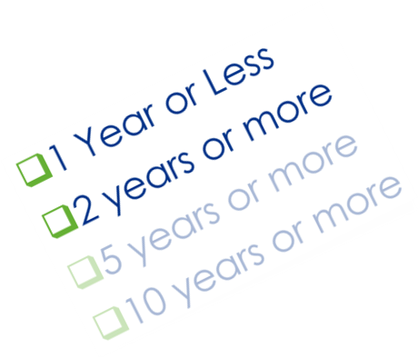
Relationship with Your Doctor
How long have you been with your primary care doctor?
1 Year or Less
2 years or more
5 years or more
10 years or more
Are ALL doctors the same?
Notes:
How long have you been with your primary care doctor?
1 Year or Less
2 years or more
5 years or more
10 years or more
Are ALL doctors the same?
Get feedback from the attendees

Slide 4
Relationship with Your Doctor
How many of you feel that you have a good doctor?
How many of you would:
Never change doctors
Change doctors if your health needs changed
Change doctors if there was something better AND you knew how to find it?
Notes:
How many of you feel that you have a good doctor?
How many of you would:
Never change doctors
Change doctors if you health needs changed
Change doctors if there was something better AND you knew how to find it?
Older adults rarely ask for referrals to specialists, specific prescriptions, express concerns or follow-up after medical visits. Instead, they trust their doctors to advocate for their health needs, according to a study.
The findings highlight a disconnect between the expectations of older adults and the realities of a changing health care system, in which doctors have less time to spend with patients. Researchers found that the more adults 65 and older trusted the role of their doctor, the less likely they were to advocate for their health concerns.
Patient initiative and shared decision-making are increasingly important factors in the quality of care and patient satisfaction. Older patients, however, may not fully share in this approach, having grown up with a more paternalistic model of care, the researchers pointed out. Patient empowerment may be further limited among those with less education and health literacy, as well as among members of racial and ethnic minority groups. If patients incorrectly assume their physician will act and advocate on their behalf, it could lead to poorer overall health, particularly for those living with one or more chronic conditions such as diabetes or high blood pressure
Source: https://www.nextavenue.org/older-adults-trust-physicians-advocate/

Slide 5
Relationship with Your Doctor
If you were able to find a better…
Doctor, would you change?
Hospital, would you change?
Health plan, would you change?
Changing your doctor or health plan is a SERIOUS decision!
Notes:
If you were able to find a better:
Doctor, would you change?
Hospital, would you change?
Medicare Advantage Prescription Drug Plan (MAPD), would you change?
Changing your doctor or your health plan is a serious decision. Sometimes, the decision to switch is out of necessity.
Get feedback from the attendees

Slide 6
Relationship with Your Doctor
Health Care is Changing!
Doctors have fewer personal relationships and continuity with patients
Patient initiative and shared decision making are more important than ever
Taking control of your health and healthcare will lead to better health outcomes
Notes:
Patients need to advocate for themselves these days. The path of healthcare is gearing much more towards patient led treatments, and less towards patient hand holding.
Patient initiative and shared decision-making are increasingly important factors in the quality of care and patient satisfaction. Older patients, however, may not fully share in this approach, having grown up with a more paternalistic model of care, the researchers pointed out. Patient empowerment may be further limited among those with less education and health literacy, as well as among members of racial and ethnic minority groups. If patients incorrectly assume their physician will act and advocate on their behalf, it could lead to poorer overall health, particularly for those living with one or more chronic conditions such as diabetes or high blood pressure.
Source: https://www.nextavenue.org/older-adults-trust-physicians-advocate/

Slide 7
Qualities of a Good Doctor
What makes a doctor better than others?
My doctor must:
Take his or her time with me
Speak my language
Be experienced
Be friendly
Have modern medical technology
Offer programs to keep me healthy
Notes:
Open discussion
In your opinion, What makes a doctor better than others?
My doctor must:
Take his or her time with me
Like listening to me and clearly communicate my options
Speak my language
My doctor must be able to speak to me in my language and understand my culture
Be experienced
The doctor must be experienced and have an experienced staff and work closely with mu specialist and health plan to manage my care
Be friendly
My doctor must be kind and attentive to my needs
Have modern medical technology
Offer programs to keep me healthy
Are there any other you can think of?

Slide 8
Finding a Good Doctor
What is the best way to find a good Primary Doctor?
Search within your health plans network
Find a doctor that accepts Medicare
Asking friends or family for a suggestion
Find a physician affiliated with a practice or professional network
Find a doctor that is local and easily accessible
Notes:
A Primary Doctor also called a Primary Care Physician (PCP) for elderly patients is called a geriatrician. This kind of physician has finished a residency in either internal medicine or family medicine and is board-certified to treat older adults. It's important to see a geriatrician because they specialize in treating the complex medical needs aging requires.
Are You Covered By Health Insurance?
If you use an insurance provider to cover your medical expenses, your choice might be limited to a specific pre-determined list of in-network physicians. As you probably already know, your freedom of choice when it comes to healthcare providers depends on what type of plan they have. Start narrowing down the list based on your insurance plan.
Are You Covered By Medicare?
If you have coverage under Medicare, the Medicare.gov “Care Compare" website is a comprehensive search engine that lists various health care providers in your area. On this website, you can search for a primary doctor by last name, a group practice name or a specific medical condition, as well as by body part or organ system.
Source:
https://www.medicare.gov/care-compare/
https://www.verywellhealth.com/finding-the-best-doctor-for-elderly-mother-2966664#:~:text=If%20your%20parents%20have%20coverage,(PHP)%20in%20her%20area
Consider Asking for a Suggestion
Sometimes getting a suggestion from a person or organization you trust is the best way to find the right primary doctor. Here are some suggestions:
Talk to friends, neighbors or relatives who see a geriatrician they are happy with.
Ask other health professionals you know, including your previous provider or your local pharmacist.
Consult an advocacy group.
Other Important Considerations
To find the best PCP for you, take a look at these important considerations before making your choice:
Location: Choose a PCP with a location close to your home and consider the location's convenience for your caregiver who may, now or in the future, bring you to appointments.
Standards of Excellence: Look for a physician affiliated with a practice or professional network that requires high standards and a good record of positive patient outcomes. Standards of excellence include board certifications and associations with leading medical associations.
Source: https://www.verywellhealth.com/finding-the-best-doctor-for-elderly-mother-2966664

Slide 9
Benefits of a Good Health Plan
What makes a health plan better than another?
My health plan must:
Have many doctors and hospitals in their network
Have low premiums and co-pays
Provide affordable prescription drug coverage
Cover rides to and from my doctors’ visits
Offer programs to keep me healthy
Have excellent customer service
Notes:
Open discussion
This is a list of things that came to mind when were asked this question
My health plan must:
Have many doctors and hospitals in their network
Have low premiums and co-pays
Provide affordable prescription dug coverage
Cover rides to and from my doctors visits
Offer programs to keep me healthy
Have excellent customer service
Are there any other you can think of?
Having a health plan that is contracted with your doctors is a great starting point. Doctors are important to your healthcare needs, and having the ability to see providers that you know and trust will make you more likely to keep seeing them regularly.
Health plans should work within your budget, and not cause stress on your financial situation. Make sure that you aren’t paying too much for your health plan, and consider options that have little or no premiums. Along with premiums, make sure to check what copayments, coinsurance, and prescription drugs will cost on your plan. There are so many choices out there, you want to make sure that you are on the right plan for your healthcare needs.

Slide 10
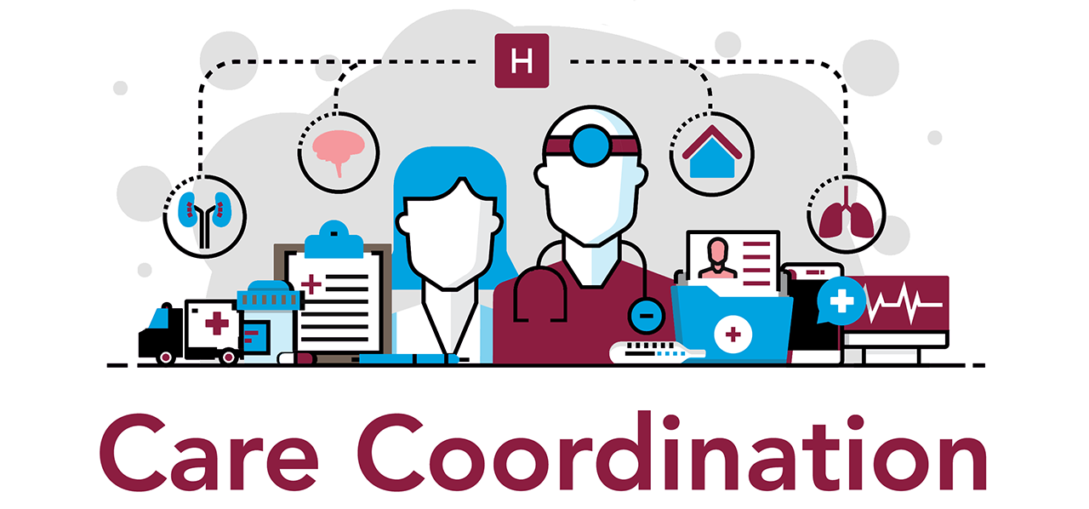
Benefits of a Good Health Plan
What makes a health plan better than other?
My health plan must:
Provide peace of mind
Out-of-pocket limits
Caregiver support
Coordinate care with my doctor and specialist to ensure I stay healthy
Notes:
Open discussion
My health plan must:
Provide peace of mind
Out-of-pocket limits
Caregiver support
Coordinate care with my doctor and specialist to ensure I stay healthy
Having peace of mind when it comes to your health plan can make a big difference. If you are worried that you will not receive the care you need, it could cause long term worry and stress. We want to remember that we have options, and that we are not “stuck” in the health plan that we have signed up for.
Thinking about things like caregiver support and out of pocket limits are a good place to start. If you are in need of full time care, you know that your care taker too needs some time off. Ask your health plan if they have things like respite care, that provide relief to full time caregivers. Providing personal time for your caregiver will make you both happier in the long run. Out of pocket limits are another topic to consider, especially when thinking about the worst case scenario. Out of pocket limits will tell you what the maximum amount of money you will have to pay in a calendar year if something terrible happens. This amount is sometimes also called the Maximum out of pocket or MOOP.
Having a plan that focuses on care coordination is another important thing to consider. If you have a primary care doctor who is involved, they can help guide you through care. Plans that are called HMO’s (Health Maintenance Organizations) provide this type of care. They consider the Primary doctor the “gate keeper” and they are responsible for coordinating your care between your specialists and your medications. Having someone who is responsible for the coordination takes the pressure off of you as the patient, and lets the medical professionals take care of your health care journey.

Slide 11
Doctor and Health Plan Check
How did you feel after evaluating your doctor?
Do you feel your doctor is providing all the care you need?
Notes:
How did you feel after evaluating your doctor?
Do you feel your doctor is providing all of the care you need?
Open discussion
It is important to constantly be thinking about your doctor and what services they are providing you. Understanding what is available to you and your options, can help you make a more informed decision about your healthcare needs.
Meanwhile, how can seniors stand to benefit from age-friendly health systems with these characteristics?
Senior patients will benefit from care aligned with their goals. Many also become more independent and functional while reducing the risk of common geriatric concerns, such as polypharmacy, delirium, falls and incontinent. An age-friendly health care system can also lead to better pain management, more proactive decision making during transitions, and increased recognition and support for families.
Various resources - https://www.webmd.com/healthy-aging/default.htm

Slide 12
Doctor and Health Plan Check
How did you feel after evaluating your health plan?
Do you think you get all you need and deserve from your health plan?
Notes:
How did your health plan do?
Do you think you get all that you need and deserve from your doctor and/or health plan?
Open discussion
When considering all that we have discussed today, do you think that your health plan passed the test? Or are there some major things missing?
Remember that you always have the option to choose a new health plan when you don’t feel that your current one is up to your standards. you have no obligation to either your health plan or provider to stay with them, and choosing what is right for you and your health is more important.

Slide 13
What questions do you have?

Slide 14
THANK YOU
for attending!

